Slide 1
ANNAMACHARYA INSTITUTE OF TECHNOLOGY AND SCIENCES::TIRUPATI
PRESENTATION ON
VEHICLE DESIGNING AND AUTONOMOUS VEHICLES
Under the platform of PROWORK FOUNDATION
SUBMITTED BY
R.LOKA VIGNESWAR REDDY
(21AK5A0321)
DEPARTMENT OF MECHANICAL ENGINEERING

Slide 2
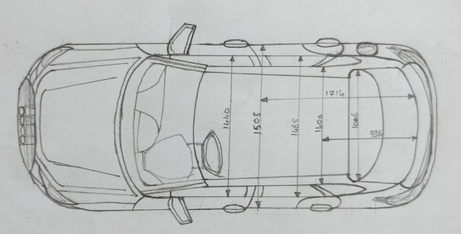
Audi_RSQ3SSportback Top view

Slide 3
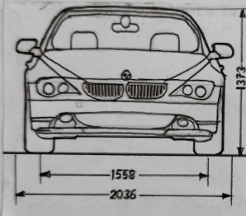
Lexus_RX_450h Front view

Slide 4
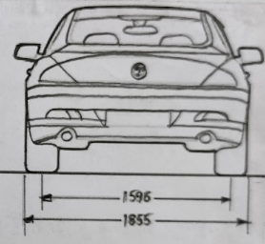
Lexus_RX_450h rear view

Slide 5
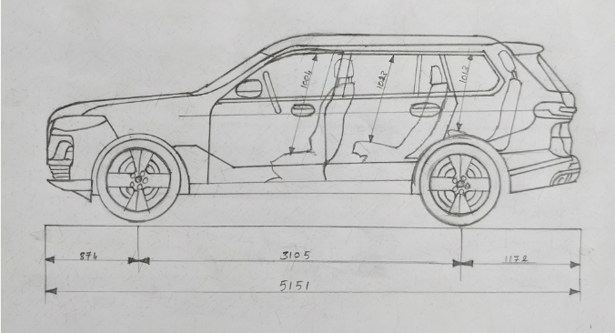
BMW_6er_GranTurismo Side view

Slide 6
Thank you

